Slide 1
Asperger Profile & Mental Health Disability Task Force
October 17, 2019

Slide 2
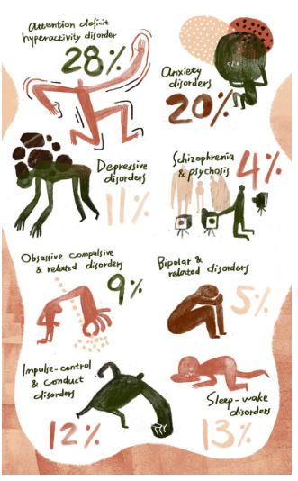
RESEARCH
Meta study by Stephanie Ameis at the University of Toronto, 2019
(Picture from Spectrum Newsletter)

Slide 3
Some issues with this data

Slide 4
From what we see these numbers undercount these issues for those with an Asperger profile

Slide 5
What we see
Anxiety prevalent with 90% of our members
Sleep is an issues with a majority of our members
ADD particularly the executive functioning component of ADD affects about 90% of our members
Depression 60% of our members
Impulse control/conduct is more of an issue for younger children or for adults in situations they consider threatening

Slide 6
Missing crucial mental health issues
Post traumatic stress
Computer addiction
Eating disorders
Alcohol & drug addiction? (no numbers)

Slide 7
Misdiagnosis
People with autism, especially women and those who are verbal with a higher IQ , the autism is missed and they get a diagnosis of a mental illness. (NAMI)

Slide 8
Mental Health Issues look different (not classical textbook) in someone on the autism spectrum creating confusing about diagnosis and treatment

Slide 9
Many of the folks we know have multiple mental health issues

Slide 10
An interesting sidenote:
Many of these mental health issues (ADD & anxiety) affect non-autistic siblings (Dr. Sally Ozonoff, Ph.D. UC Davis Health, unpublished current research)

Slide 11
OCD?? Perseveration in the brain, in action.

Slide 12
Bipolar? natural variability of mood often dependent of environment

Slide 13
Some additional questions without answers

Slide 14
Depression?? Chronic due to understanding of difference and/or not achieving goals. Biological?

Slide 15
Eating disorders? Due to sensory issues??
Biological?

Slide 16
Post Traumatic Stress? Chronic feeling of trauma from not understanding social environment, people’s intentions and from bullying

Slide 17
Lack of mental health care providers knowledgeable about the intersection of Autism and mental health. Need to train:
Psychiatrists
Psychopharmacologists
Therapists
ER
Outpatient hospitalization
Inpatient hospitalization

Slide 18
“Care has to be comprehensive and continuous.”
Thomas Insel

