Slide 1
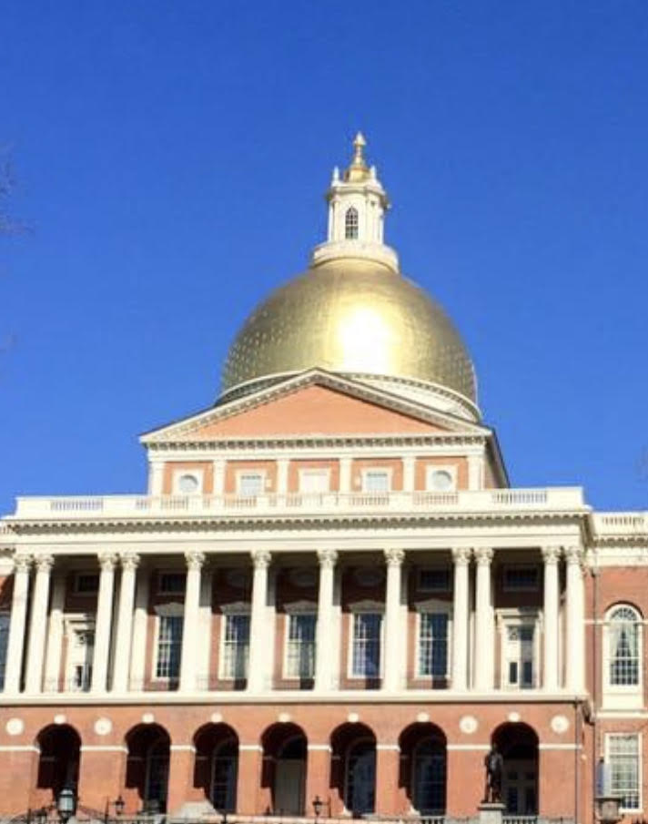
The Arc of Massachusetts Update Summary of Issues we Face: FY 2021 Budget for Persons with Autism and other Intellectual and Developmental Disabilities
Maura Sullivan
Dir of gov affairs and operation house call
October 2020

Slide 2
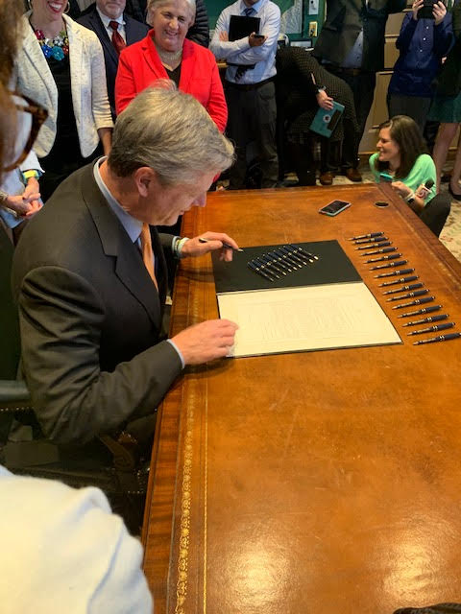
The Arc advocates for…
Maintaining all of the Governor’s Revised FY’2021 Budget recommendation, which mainly reflects the Governor’s January proposal.
But due to COVID pandemic there are significant additions to the budget that must be secured in addition to addressing a reduction of $34 Million in day/employment services.
*We must ensure a stable safety net and support families and prevent day program closures. Sustaining our services for future is critical.

Slide 3
DDS Day Programs
Day and Day Habilitation - August 4 agencies
Billing -Revenue | Expense
102,596 | 166,950
39,897 | 118,701
344,937 | 615,379
562,798 | 842,513
(DDS) Day and Employment line item (5920-2025) is short by 13.4% or equal to the estimated loss of services to approximately 1,500 people and must reflect the original 2021 request of $253,891,529 (restore $34 Mil).
It’s also critical that the administration also allow billing at rates for these services which match typical utilization in range of 95% (pre-COVID).
The infection control regulations and transportation limitations do result in higher costs per person.

Slide 4
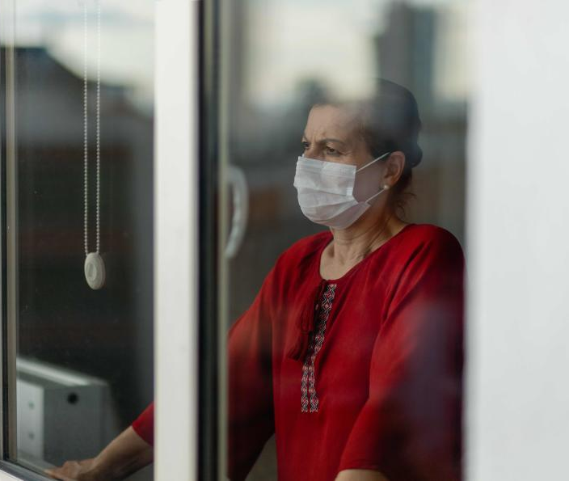
Residential, Families and Individuals
The COVID pandemic has had a devasting impact on our community.
We now realize that additional COVID related costs in residential services and for families or individuals living semi-independently are NOT covered in the revised budget.
The situation has worsened since early summer.
Families need more! Food insecurity, Behavior supports, mental health,

Slide 5
Other budget concerns, covid-19 expenses and beyond
The Special Education Circuit Breaker – DESE-DDS
Family Support,
POS Reserve funding 1/21
Covid-19 specific
Surge capacity staffing, testing PPE, Workforce shortage and compensation.
Beyond Covid-19
How do we facilitate a transition to a new way of providing services? How do we ensure there are no limitations in supporting personal preferences and community connections? The Arc is positioning to help bridge this transition

Slide 6
Federal update: stimulus rumblings grow, perhaps a robust compromise. Less than House, but still large. Follow @TheArcUS
VOTE!
Join Ellen Taverna
at noon today
for voting info

Slide 7
Not all bad news – our community and organizational advocacy has impact!
Funding gains during crisis
Over 30,000 emails sent regarding state safety net, pay equity and health equity
Abuse Registry passed in 2020 and funded
DDS communication weekly, with others in administration as needed
Virtual meetings with State House leadership and over 120 legislators reached personally in September
Federal delegation outreach/education and funding/policy work with CMS
Nearly 100 webinars offered since March and more coming with a new schedule, focus groups – new focus on T22
Healthcare triage training site takes off and OHC pivots, add hundreds and begins a pilot with Harvard.
www.thearcofmass.org/covid19

